Slide 1
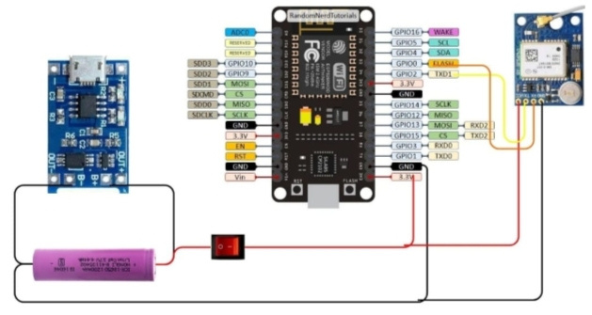
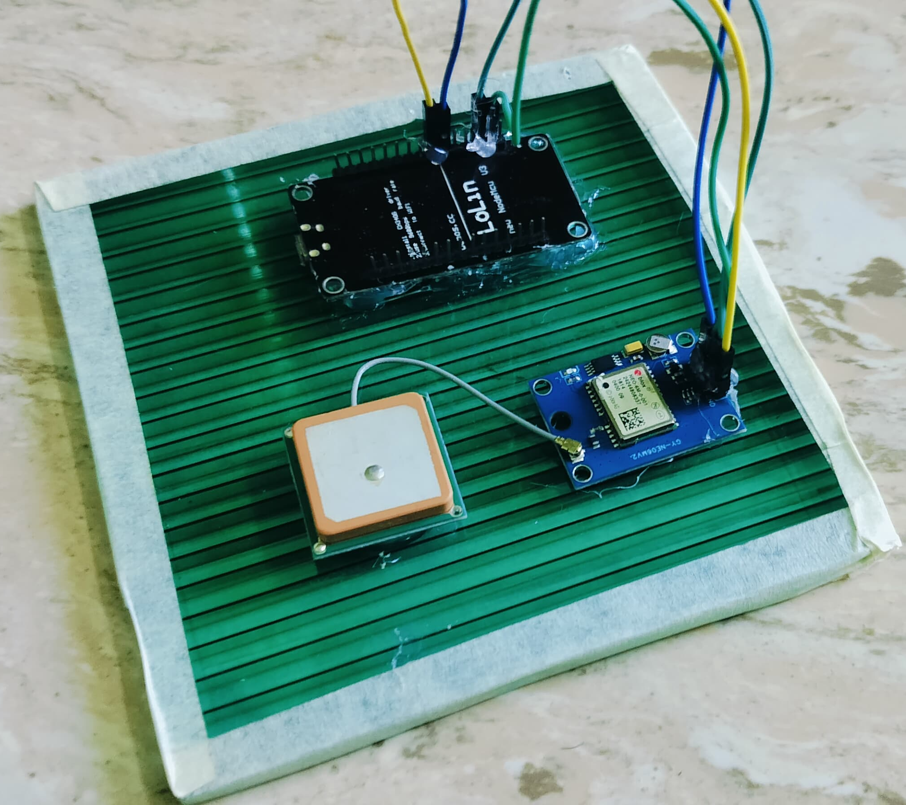
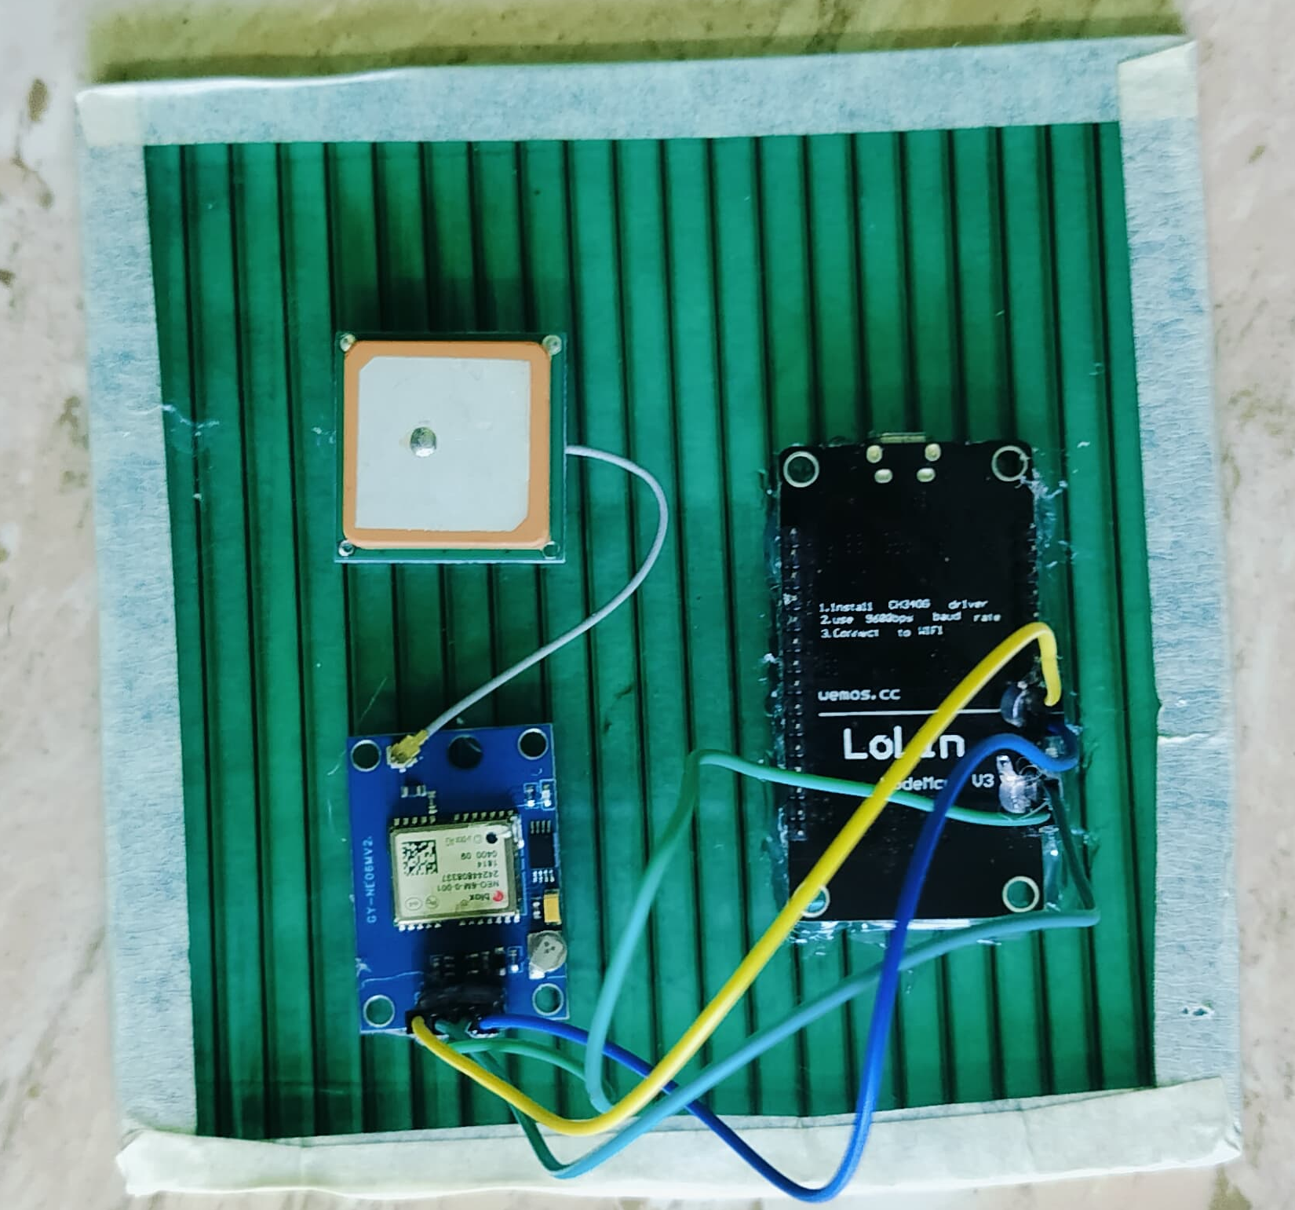
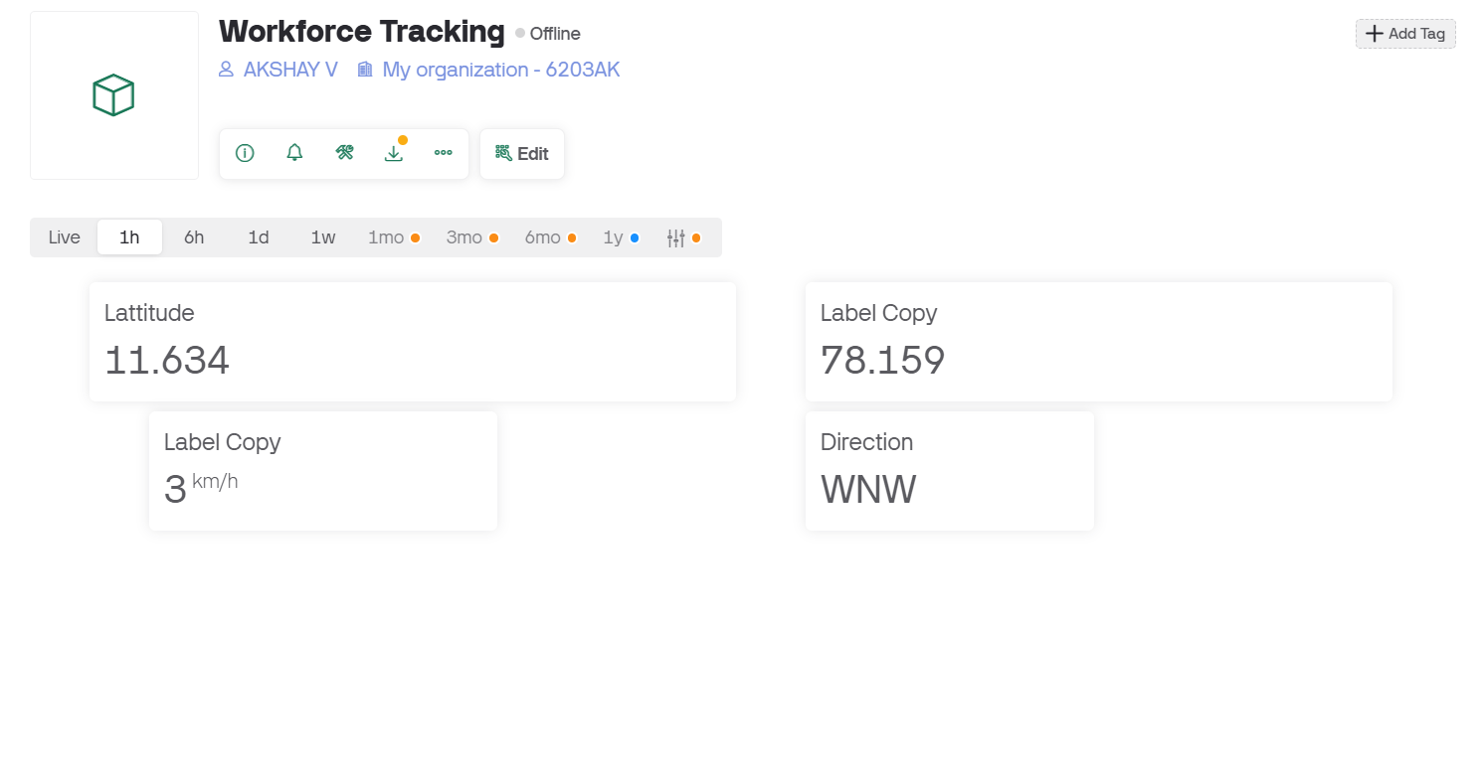
Smart Workforce Tracker
* Previous Phase: Created a proof of concept to track a person using a Latitude and Longitude, and tracking the Speed and Direction. Components used: NodeMCU, Neo-6 GPS module.
* In the next phase, In the next phase, we will enhance the system by implementing worker tracking for improved monitoring and extended operational insights and integrating batteries for reliable power and extended usage time. A virtual boundary will be established to track the location of the workers, enabling the system to monitor whether they are inside or outside the designated area. Additionally, the system will count the number of times the workers enter and exit the boundary and measure the time they spend resting. These improvements will not only enhance the system’s performance but also offer greater functionality, paving the way for more advanced applications in real-world scenarios.
Discrimination :
• Smart Workforce Tracker uses the GPS signals from the tracking device to pinpoint the location and marks the limits of an area of the workers. This is the Smart Workforce Tracker.

